Slide 1
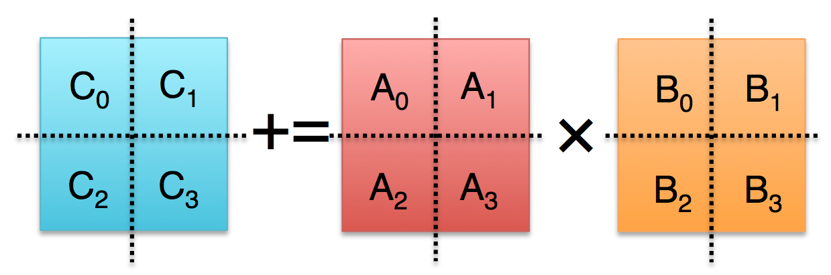
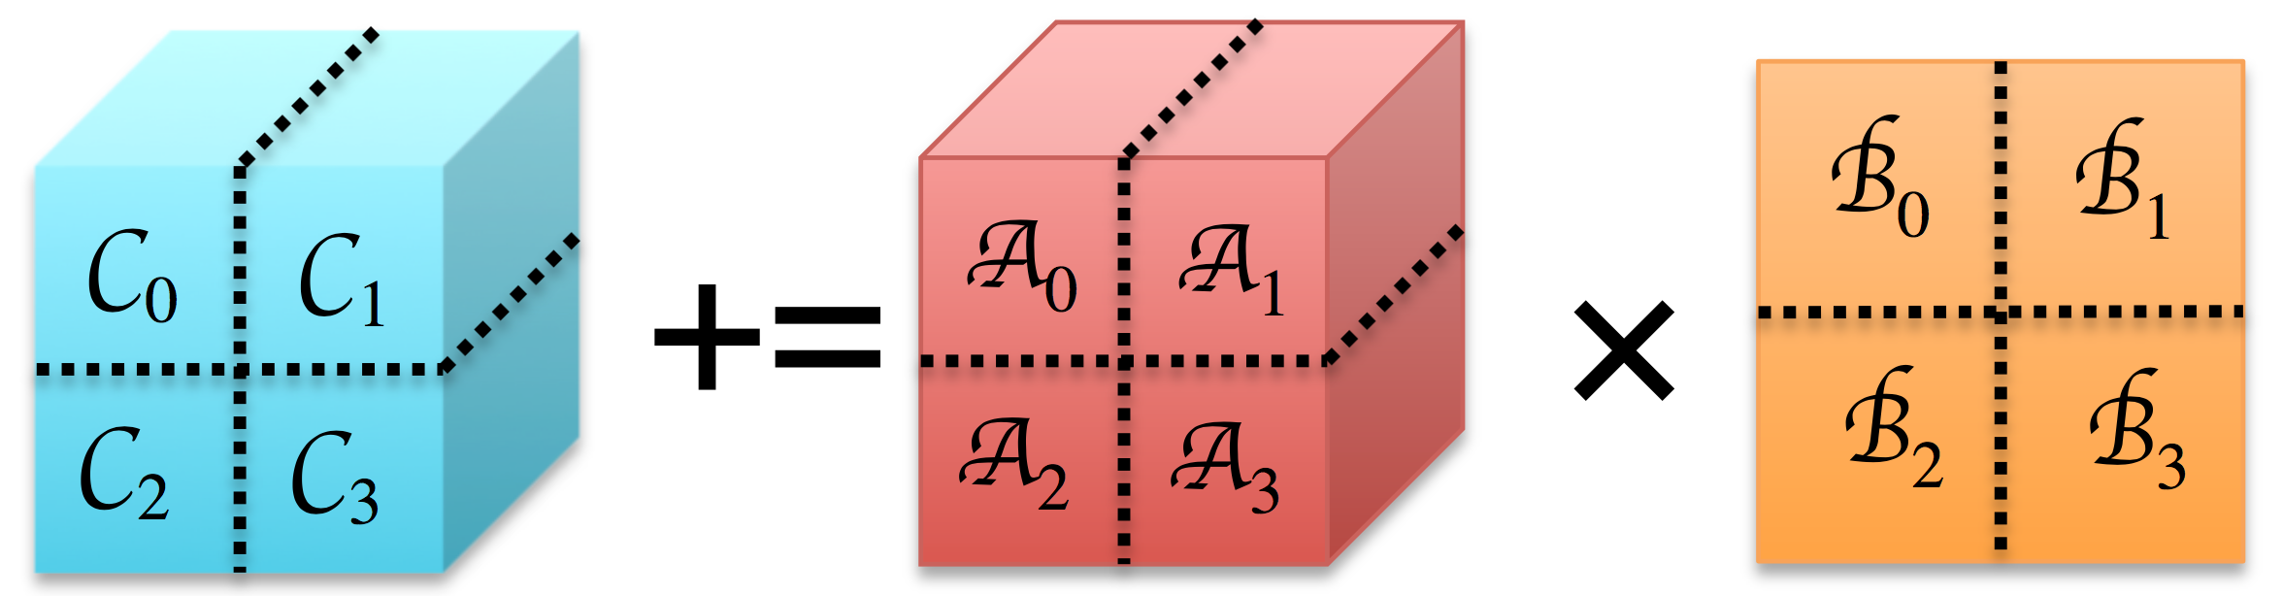

Strassen’s Algorithm for Tensor Contraction
Jianyu Huang, Devin A. Matthews, Robert A. van de Geijn
The University of Texas at Austin
September 14-15, 2017
Tensor Computation Workshop
Flatiron Institute, 162 Fifth Ave, New York City.

Slide 2

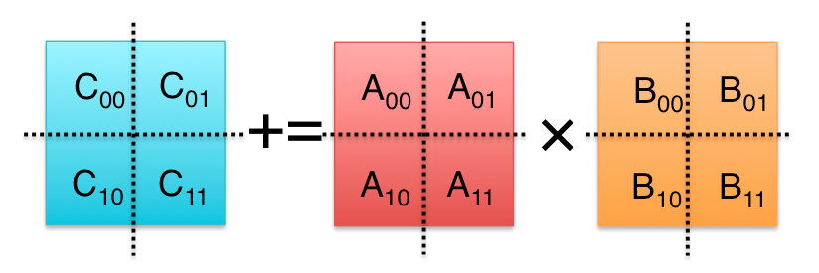
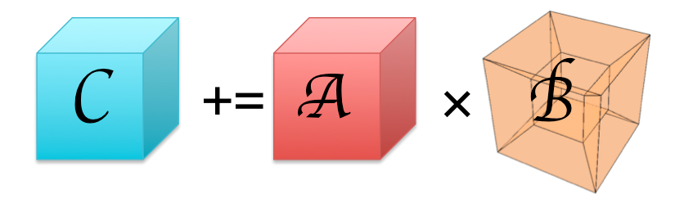
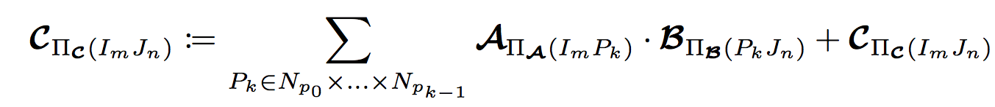
Marry Strassen with Tensor Contraction
?
M₀ := (A₀₀+A₁₁)(B₀₀+B₁₁);
M₁ := (A₁₀+A₁₁)B₀₀;
M₂ := A₀₀(B₀₁–B₁₁);
M₃ := A₁₁(B₁₀–B₀₀);
M₄ := (A₀₀+A₀₁)B₁₁;
M₅ := (A₁₀–A₀₀)(B₀₀+B₀₁);
M₆ := (A₀₁–A₁₁)(B₁₀+B₁₁);
C₀₀ += M₀ + M₃ – M₄ + M₆
C₀₁ += M₂ + M₄
C₁₀ += M₁ + M₃
C₁₁ += M₀ – M₁ + M₂ + M₅
Practical Speedup?
O(n³) → O(n^{2.8})

Slide 3
Outline
Proposal
Background
High-performance GEMM
High-performance Strassen
High-performance Tensor Contraction
Strassen’s Algorithm for Tensor Contraction
Performance Model
Experiments
Conclusion
Marriage

Slide 4
High-performance matrix multiplication (GEMM)

Slide 5
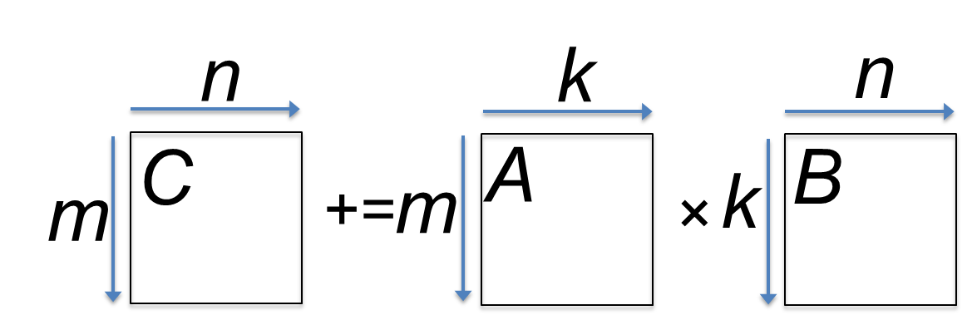
State-of-the-art GEMM in BLIS
BLAS-like Library Instantiation Software (BLIS) is a portable framework for instantiating BLAS-like dense linear algebra libraries.
BLIS provides a refactoring of GotoBLAS algorithm (best-known approach on CPU) to implement GEMM.
GEMM implementation in BLIS has 6-layers of loops. The outer 5 loops are written in C. The inner-most loop (micro-kernel) is written in assembly for high performance.
Field Van Zee, and Robert van de Geijn. “BLIS: A Framework for Rapidly Instantiating BLAS Functionality.” ACM TOMS 41.3 (2015): 14.
Kazushige Goto, and Robert van de Geijn. “High-performance implementation of the level-3 BLAS.” ACM TOMS 35.1 (2008): 4.
Kazushige Goto, and Robert van de Geijn. “Anatomy of high-performance matrix multiplication.” ACM TOMS 34.3 (2008): 12.

Slide 6
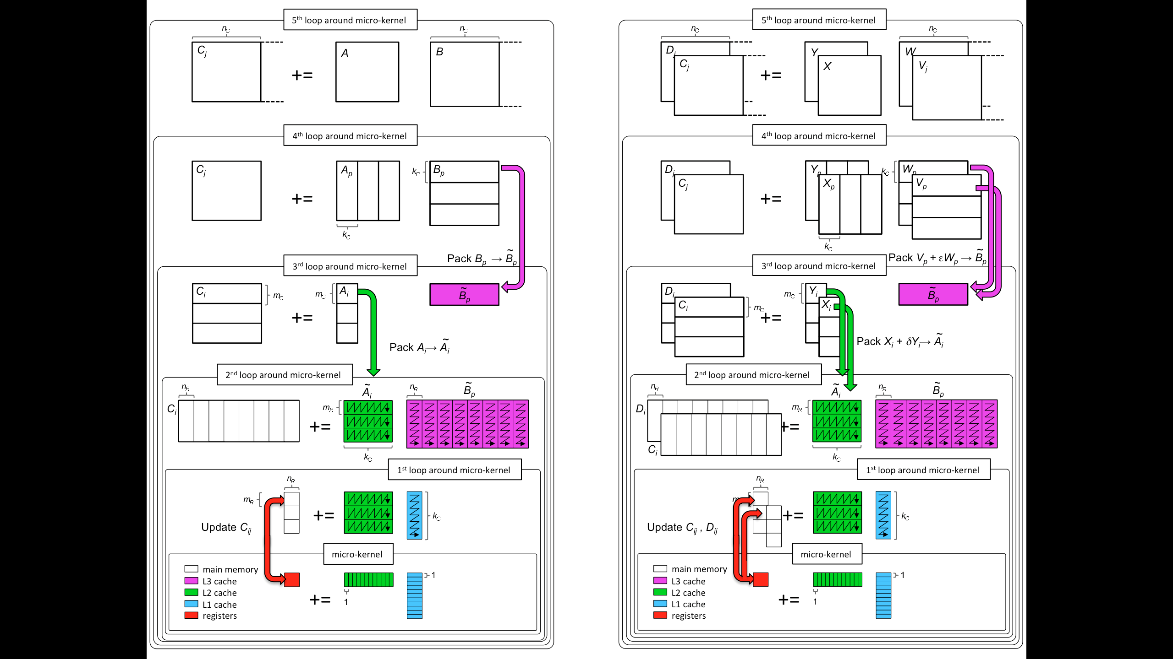
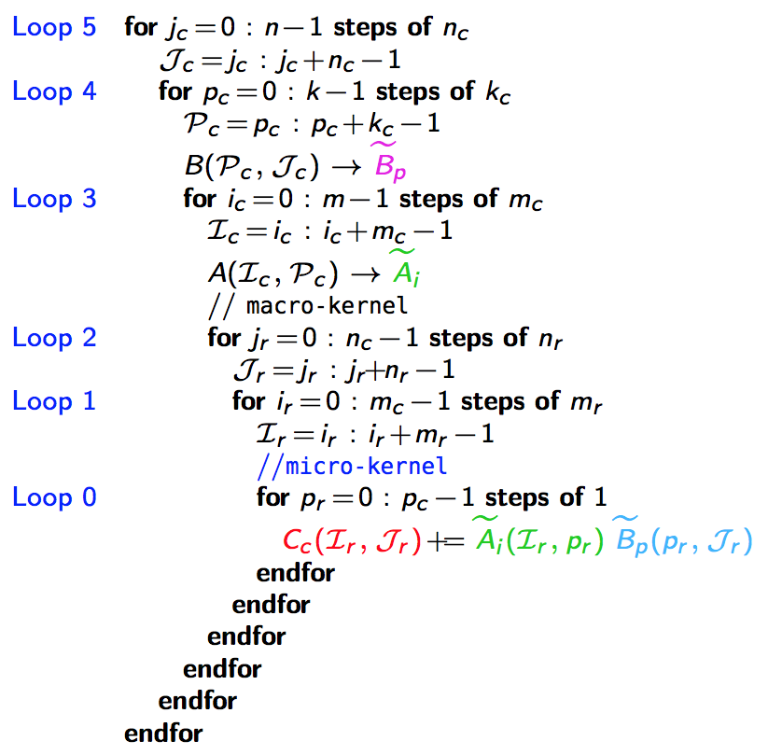
GotoBLAS algorithm for GEMM in BLIS
k_{C} x n_{C}
L3 Cache
m_{C} x k_{C}
L2 Cache
m_{R} x n_{R}
*Field G. Van Zee, and Tyler M. Smith. “Implementing high-performance complex matrix multiplication via the 3m and 4m methods.” In ACM Transactions on Mathematical Software (TOMS), accepted.
Register
m_{R} x k_{C}
k_{C} x n_{R}

Slide 7
High-performance Strassen
*Jianyu Huang, Tyler Smith, Greg Henry, and Robert van de Geijn. “Strassen’s Algorithm Reloaded.” In SC’16.

Slide 8
Strassen’s Algorithm Reloaded
M₀ := (A₀₀+A₁₁)(B₀₀+B₁₁);
M₁ := (A₁₀+A₁₁)B₀₀;
M₂ := A₀₀(B₀₁–B₁₁);
M₃ := A₁₁(B₁₀–B₀₀);
M₄ := (A₀₀+A₀₁)B₁₁;
M₅ := (A₁₀–A₀₀)(B₀₀+B₀₁);
M₆ := (A₀₁–A₁₁)(B₁₀+B₁₁);
C₀₀ += M₀ + M₃ – M₄ + M₆
C₀₁ += M₂ + M₄
C₁₀ += M₁ + M₃
C₁₁ += M₀ – M₁ + M₂ + M₅
M₀ := (A₀₀+A₁₁)(B₀₀+B₁₁); C₀₀ += M₀; C₁₁ += M₀;
M₁ := (A₁₀+A₁₁)B₀₀; C₁₀ += M₁; C₁₁ –= M₁;
M₂ := A₀₀(B₀₁–B₁₁); C₀₁ += M₂; C₁₁ += M₂;
M₃ := A₁₁(B₁₀–B₀₀); C₀₀ += M₃; C₁₀ += M₃;
M₄ := (A₀₀+A₀₁)B₁₁; C₀₁ += M₄; C₀₀ –= M₄;
M₅ := (A₁₀–A₀₀)(B₀₀+B₀₁); C₁₁ += M₅;
M₆ := (A₀₁–A₁₁)(B₁₀+B₁₁); C₀₀ += M₆;
M := (X+Y)(V+W); C +=M; D +=M;
M := (X+δY)(V+εW); C += γ₀M; D += γ₁M;
γ₀, γ₁,δ,ε ∈ {-1, 0, 1}.
General operation for one-level Strassen:
*Jianyu Huang, Tyler Smith, Greg Henry, and Robert van de Geijn. “Strassen’s Algorithm Reloaded.” In SC’16.

Slide 9
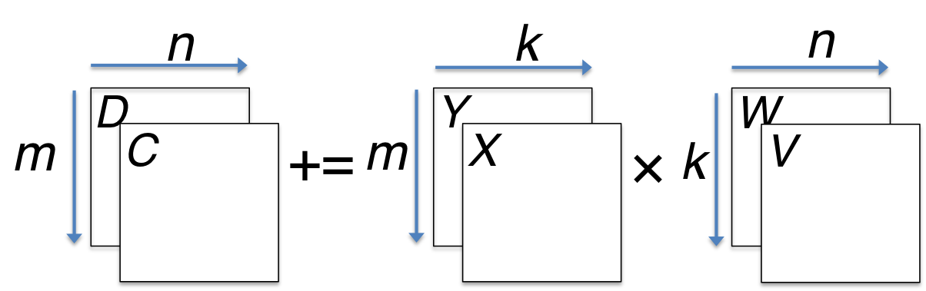
M := (X+Y)(V+W); C += M; D += M;
*Jianyu Huang, Tyler Smith, Greg Henry, and Robert van de Geijn. “Strassen’s Algorithm Reloaded.” In SC’16.

Slide 10
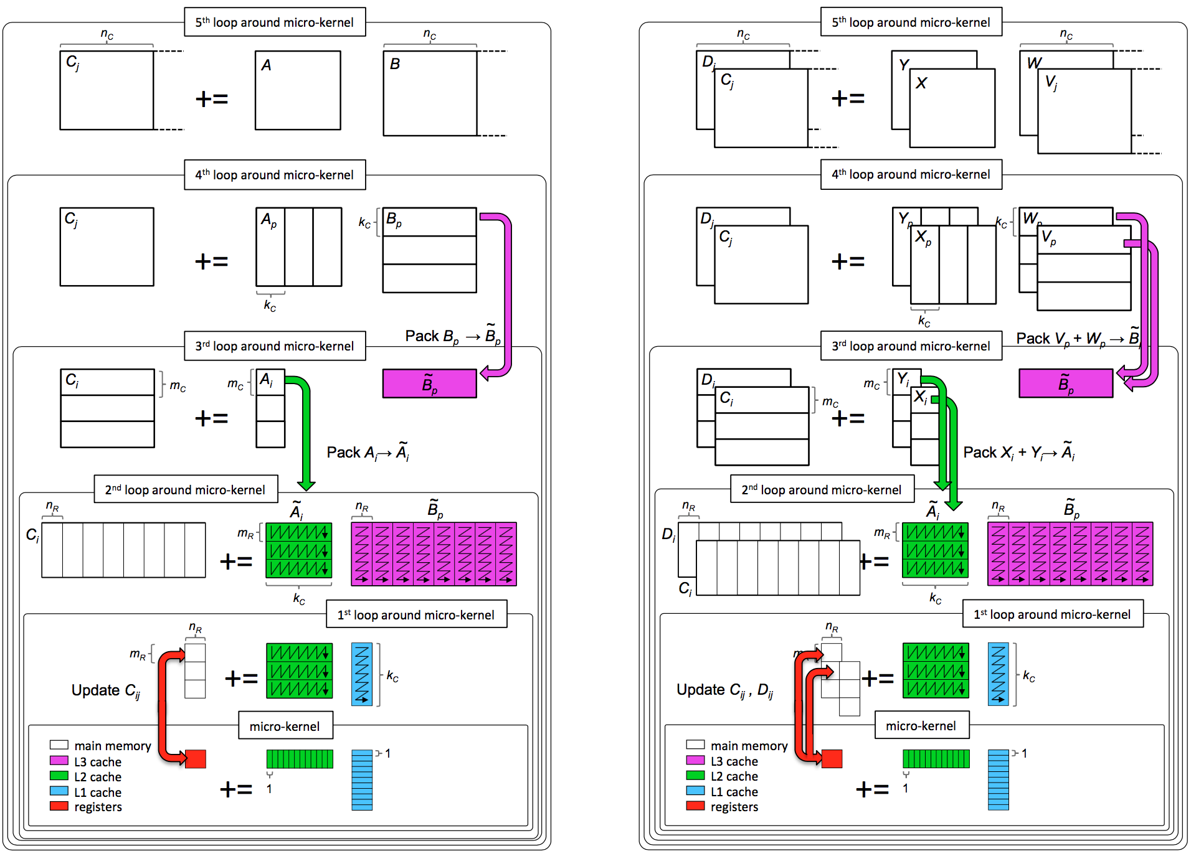
C += AB;
M := (X+Y)(V+W); C += M; D += M;

Slide 11
C += AB;
M := (X+Y)(V+W); C += M; D += M;
k_{C} x n_{C}
L3 Cache
m_{C} x k_{C}
L2 Cache
m_{R} x n_{R}
Register

Slide 12
High-performance Tensor Contraction
Devin A. Matthews. “High-Performance Tensor Contraction without Transposition.” Accepted in SISC.

Slide 13
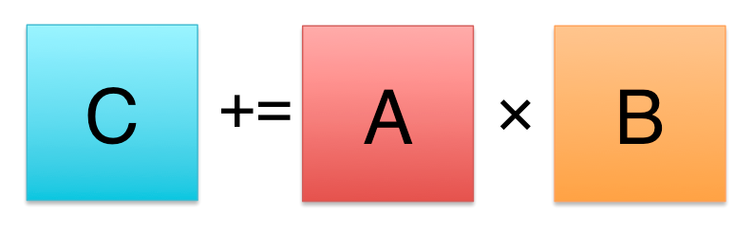
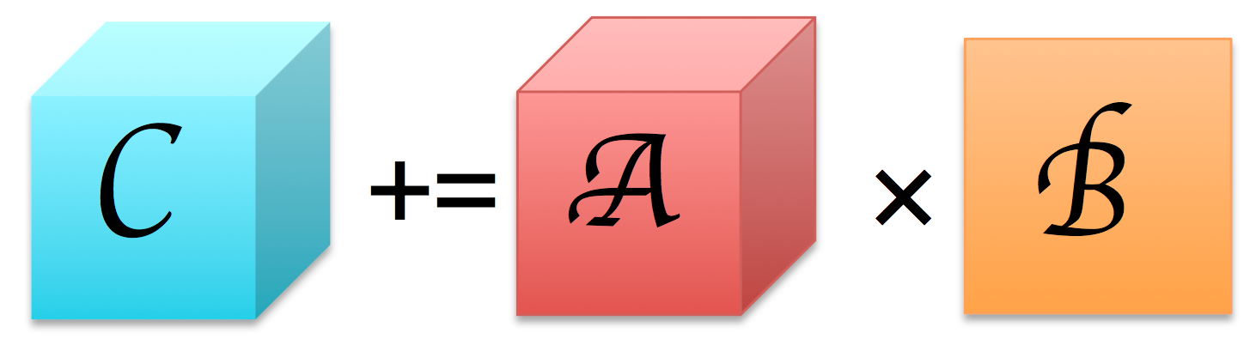
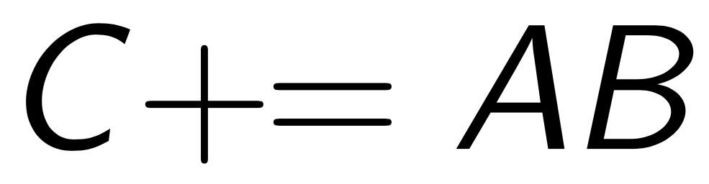
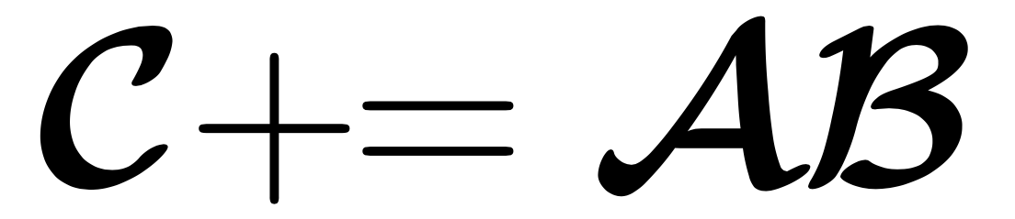
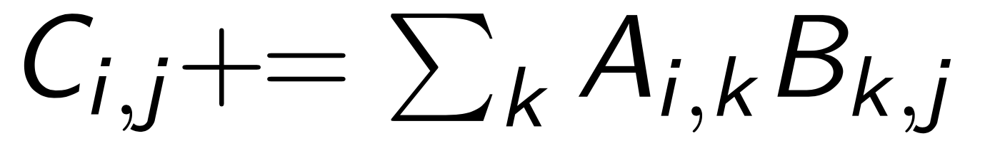
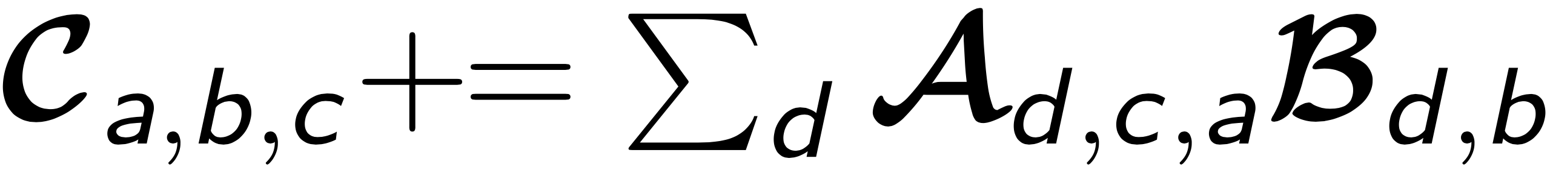
Matrix vs. Tensor
Matrix Multiplication
Tensor Contraction
BLAS/BLIS!
TBLIS/
GETT
Paul Springer, and Paolo Bientinesi. "Design of a high-performance GEMM-like tensor-tensor multiplication." arXiv preprint arXiv:1607.00145 (2016).
Devin A. Matthews. “High-Performance Tensor Contraction without Transposition.” Accepted in SISC.

Slide 14
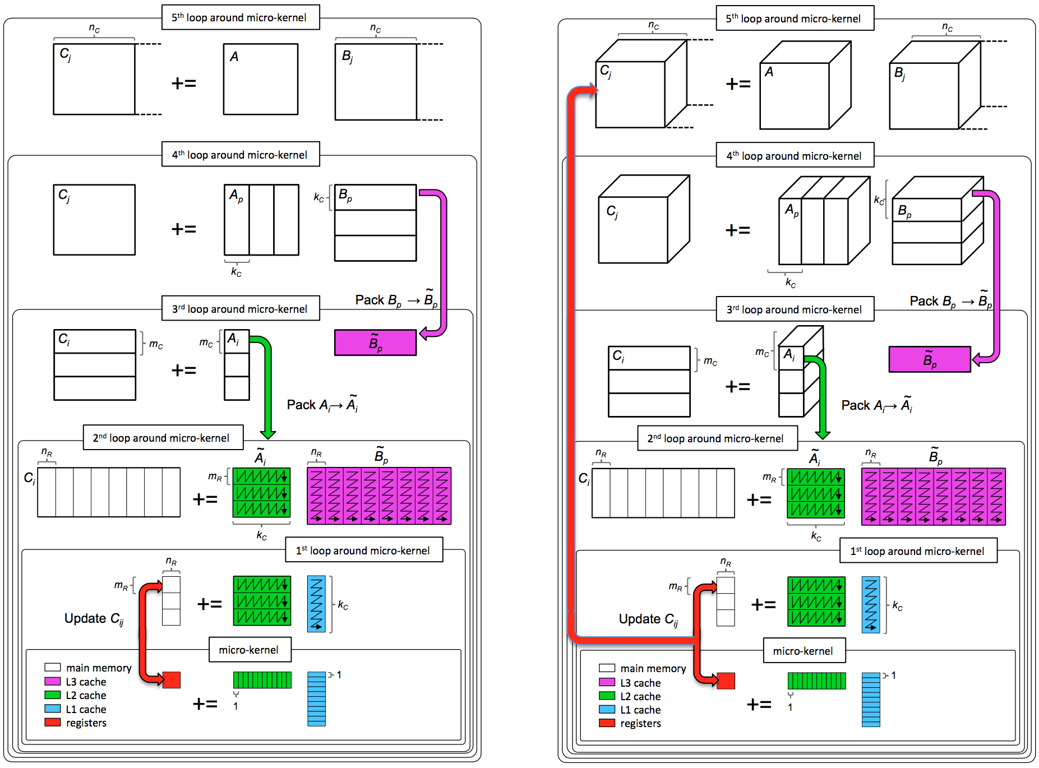
C := AB + C

Slide 15
Outline
Background
High-performance GEMM
High-performance Strassen
High-performance Tensor Contraction
Strassen’s Algorithm for Tensor Contraction
Performance Model
Experiments
Conclusion

Slide 16
Matrix vs. Tensor
Matrix Multiplication
Tensor Contraction
BLAS/BLIS!
TBLIS/
GETT
Paul Springer, and Paolo Bientinesi. "Design of a high-performance GEMM-like tensor-tensor multiplication." arXiv preprint arXiv:1607.00145 (2016).
Devin A. Matthews. “High-Performance Tensor Contraction without Transposition.” Accepted in SISC.

Slide 17
Matrix vs. Tensor
Matrix Multiplication
Tensor Contraction
BLAS/BLIS!
TBLIS/
GETT

Slide 18

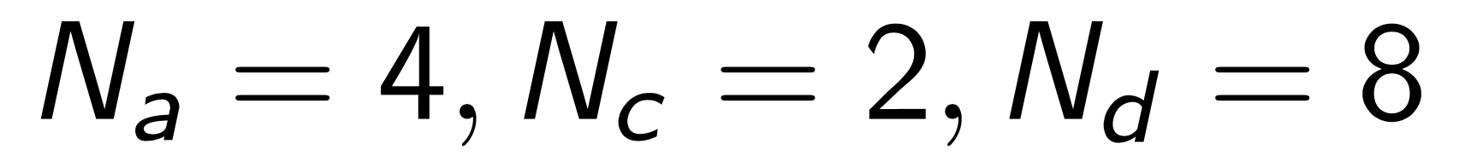
Tensors As Matrices: Block-Scatter-Matrix View
Tensor: ,
with
“d” dimension is stride-1, other dimensions have increasing strides (8, 16).
8x2x4
 |  |  | 48 | 49 | 50 | 51 | 52 | 53 | 54 | 55
 |  | 32 | 33 | 34 | 35 | 36 | 37 | 38 | 39
 | 16 | 17 | 18 | 19 | 20 | 21 | 22 | 23
0 | 1 | 2 | 3 | 4 | 5 | 6 | 7
a
c
d
 |  |  | 56 | 57 | 58 | 59 | 60 | 61 | 62 | 63
 |  | 40 | 41 | 42 | 43 | 44 | 45 | 46 | 47
 | 24 | 25 | 26 | 27 | 28 | 29 | 30 | 31
8 | 9 | 10 | 11 | 12 | 13 | 14 | 15
Devin A. Matthews. “High-Performance Tensor Contraction without Transposition.” Accepted in SISC.

Slide 19
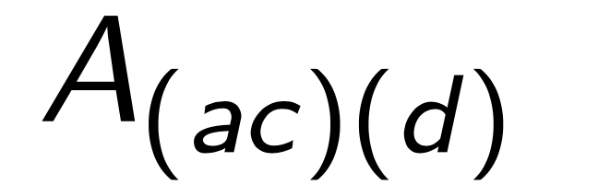
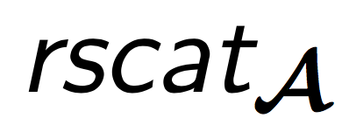
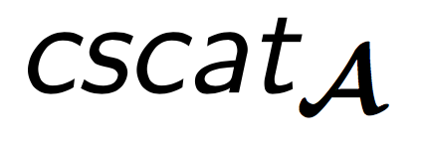
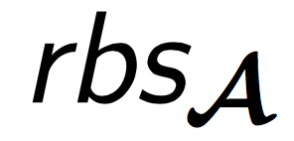

Tensors As Matrices: Block-Scatter-Matrix View
Tensor: ,
with
“d” dimension is stride-1, other dimensions have increasing strides (8, 16).
Matrix: ,
with
Column “ac” dimension has stride of “c” (8x2=16).
Row “d” dimension has is stirde-1. (i.e. A is row-major.)
, store offset for each position in rows or columns:
, store stride for each block or zero for irregular blocks:
- vector load/store instructions for stride-1 index
- vector gather/scatter instructions for stride-n index.
8x2x4
 |  |  | 48 | 49 | 50 | 51 | 52 | 53 | 54 | 55
 |  | 32 | 33 | 34 | 35 | 36 | 37 | 38 | 39
 | 16 | 17 | 18 | 19 | 20 | 21 | 22 | 23
0 | 1 | 2 | 3 | 4 | 5 | 6 | 7
a
c
d
 |  |  | 56 | 57 | 58 | 59 | 60 | 61 | 62 | 63
 |  | 40 | 41 | 42 | 43 | 44 | 45 | 46 | 47
 | 24 | 25 | 26 | 27 | 28 | 29 | 30 | 31
8 | 9 | 10 | 11 | 12 | 13 | 14 | 15
8x8
ac
d
cscat_{A}
0 | 1 | 2 | 3 | 4 | 5 | 6 | 7
cbs_{A}
1
1
rbs_{A}
rscat_{A}
Scatter-Matrix Vector
0
16
32
48
8
24
40
56
0 | 1 | 2 | 3 | 4 | 5 | 6 | 7
16 | 17 | 18 | 19 | 20 | 21 | 22 | 23
32 | 31 | 32 | 33 | 34 | 35 | 36 | 37
48 | 49 | 50 | 51 | 52 | 53 | 54 | 55
8 | 9 | 10 | 11 | 12 | 13 | 14 | 15
24 | 25 | 26 | 27 | 28 | 29 | 30 | 31
40 | 41 | 42 | 43 | 44 | 45 | 46 | 47
56 | 57 | 58 | 59 | 60 | 61 | 62 | 63
16
Block-Scatter-Matrix Vector
16
Devin A. Matthews. “High-Performance Tensor Contraction without Transposition.” Accepted in SISC.

Slide 20
Strassen’s Algorithm for Tensor Contraction
C += A × B
abc
dca
db
 |  |  | 3 | 7 | 11 | 15 | 19 | 23 | 27 | 31
 |  | 2 | 6 | 10 | 14 | 18 | 22 | 26 | 30
 | 1 | 5 | 9 | 13 | 17 | 21 | 25 | 29
0 | 4 | 8 | 12 | 16 | 20 | 24 | 28
 |  |  | 48 | 49 | 50 | 51 | 52 | 53 | 54 | 55
 |  | 32 | 33 | 34 | 35 | 36 | 37 | 38 | 39
 | 16 | 17 | 18 | 19 | 20 | 21 | 22 | 23
0 | 1 | 2 | 3 | 4 | 5 | 6 | 7
0 | 8 | 16 | 24 | 32 | 40 | 48 | 56
1 | 9 | 17 | 25 | 33 | 41 | 49 | 57
2 | 10 | 18 | 26 | 34 | 42 | 50 | 58
3 | 11 | 19 | 27 | 35 | 43 | 51 | 59
4 | 12 | 20 | 28 | 36 | 44 | 52 | 60
5 | 13 | 21 | 29 | 37 | 45 | 53 | 61
6 | 14 | 22 | 30 | 38 | 46 | 54 | 62
7 | 15 | 23 | 31 | 39 | 47 | 55 | 63
a
a
c
b
d
c
 |  |  | 35 | 39 | 43 | 47 | 51 | 55 | 59 | 63
 |  | 34 | 38 | 42 | 46 | 50 | 54 | 58 | 62
 | 33 | 37 | 41 | 45 | 49 | 53 | 57 | 61
32 | 36 | 40 | 44 | 48 | 52 | 56 | 60
 |  |  | 56 | 57 | 58 | 59 | 60 | 61 | 62 | 63
 |  | 40 | 41 | 42 | 43 | 44 | 45 | 46 | 47
 | 24 | 25 | 26 | 27 | 28 | 29 | 30 | 31
8 | 9 | 10 | 11 | 12 | 13 | 14 | 15
d
b
C += A × B
ac
b
ac
d
d
b
cscat_{C}
cscat_{A}
cscat_{B}
cbs_{C}
0 | 4 | 8 | 12 | 16 | 20 | 24 | 28
0 | 1 | 2 | 3 | 4 | 5 | 6 | 7
cbs_{B}
0 | 8 | 16 | 24 | 32 | 40 | 48 | 56
4
4
cbs_{A}
1
1
rbs_{B}
8
8
rbs_{C}
rscat_{B}
rscat_{C}
rbs_{A}
rscat_{A}
0
1
2
3
32
33
34
35
0 | 4 | 8 | 12 | 16 | 20 | 24 | 28
1 | 5 | 9 | 13 | 17 | 21 | 25 | 29
2 | 6 | 10 | 14 | 18 | 22 | 26 | 30
3 | 7 | 11 | 15 | 19 | 23 | 27 | 31
32 | 36 | 40 | 44 | 48 | 52 | 56 | 60
33 | 37 | 41 | 45 | 49 | 53 | 57 | 61
34 | 38 | 42 | 46 | 50 | 54 | 58 | 62
35 | 39 | 43 | 47 | 51 | 55 | 59 | 63
0
16
32
48
8
24
40
56
0 | 1 | 2 | 3 | 4 | 5 | 6 | 7
16 | 17 | 18 | 19 | 20 | 21 | 22 | 23
32 | 31 | 32 | 33 | 34 | 35 | 36 | 37
48 | 49 | 50 | 51 | 52 | 53 | 54 | 55
8 | 9 | 10 | 11 | 12 | 13 | 14 | 15
24 | 25 | 26 | 27 | 28 | 29 | 30 | 31
40 | 41 | 42 | 43 | 44 | 45 | 46 | 47
56 | 57 | 58 | 59 | 60 | 61 | 62 | 63
0
1
2
3
4
5
6
7
0 | 8 | 16 | 24 | 32 | 40 | 48 | 56
1 | 9 | 17 | 25 | 33 | 41 | 49 | 57
2 | 10 | 18 | 26 | 34 | 42 | 50 | 58
3 | 11 | 19 | 27 | 35 | 43 | 51 | 59
4 | 12 | 20 | 28 | 36 | 44 | 52 | 60
5 | 13 | 21 | 29 | 37 | 45 | 53 | 61
6 | 14 | 22 | 30 | 38 | 46 | 54 | 62
7 | 15 | 23 | 31 | 39 | 47 | 55 | 63
1
16
1
1
16
1
Jianyu Huang, Devin A. Matthews, and Robert A. van de Geijn. “Strassen’s Algorithm for Tensor Contraction.” arXiv:1704.03092 (2017).

Slide 21
Modifications to GEMM
M₀ := (A₀₀+A₁₁)(B₀₀+B₁₁); C₀₀ += M₀; C₁₁ += M₀;
Packing routines:
Implicit tensor-to-matrix permutations
Addition of submatrices of A and B.
Micro-kernel:
Implicit matrix-to-tensor transformations
Scatter update of submatrices of C.
Additional workspace for Transposition (Tensor Contraction)
Additional Workspace for Summation (Strassen)

Slide 22
C += AB;
M := (X+Y)(V+W); C += M; D += M;
k_{C} x n_{C}
L3 Cache
m_{C} x k_{C}
L2 Cache
m_{R} x n_{R}
Register

Slide 23
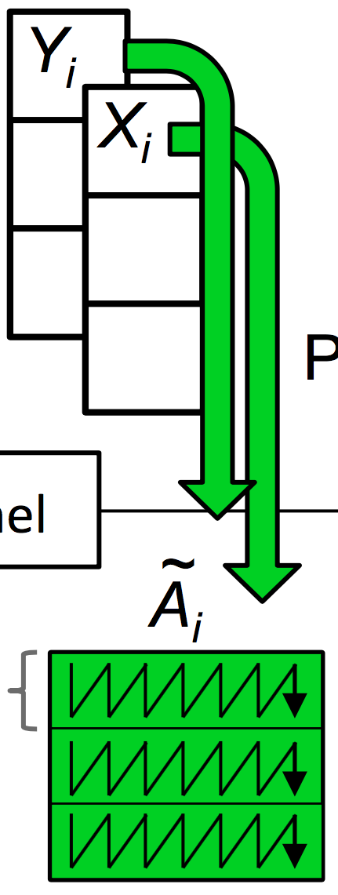
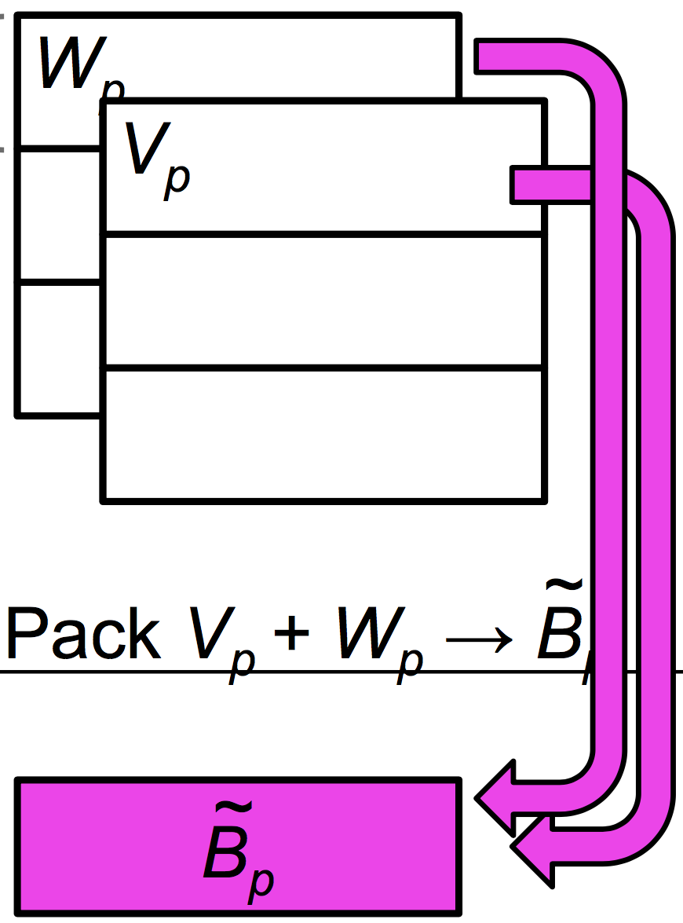
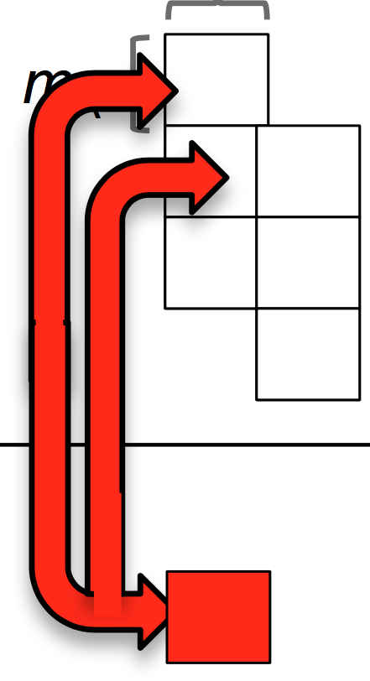

Slide 24

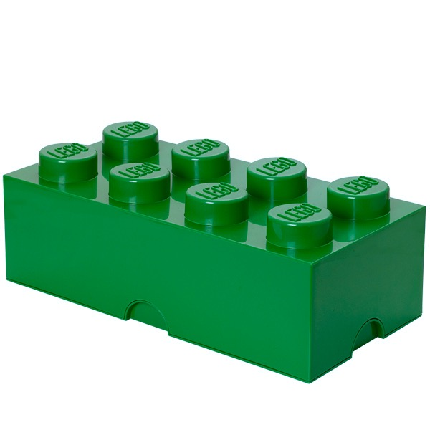
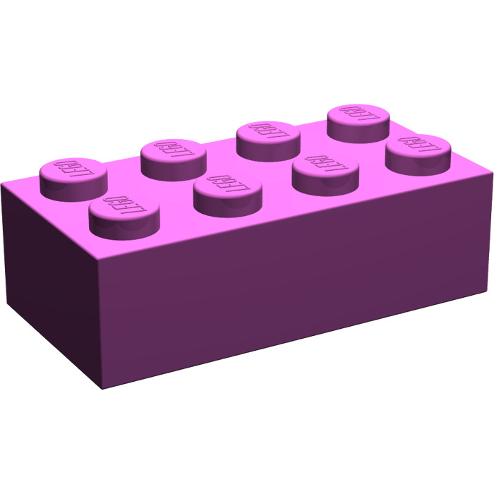
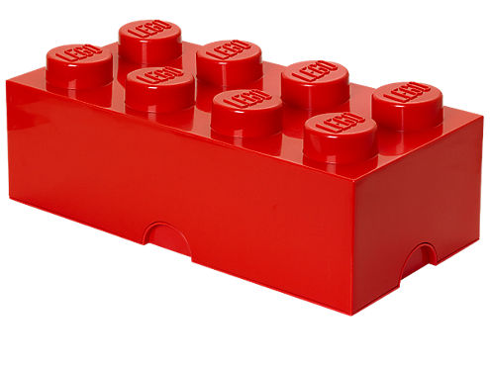
Variations on a theme
✘
✘
✘
Naïve Strassen
AB Strassen
ABC Strassen
✔
✔
✘
✔
✔
✔

Slide 25
Outline
Background
High-performance GEMM
High-performance Strassen
High-performance Tensor Contraction
Strassen’s Algorithm for Tensor Contraction
Performance Model
Experiments
Conclusion

Slide 26
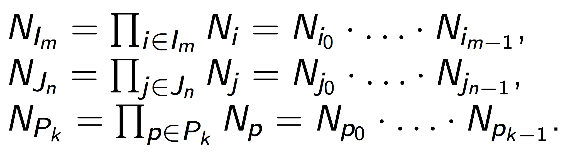
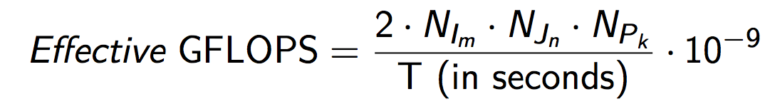
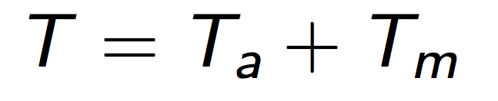
Performance Model
Performance Metric
Total Time Breakdown
Arithmetic
Operations
Memory
Operations

Slide 27
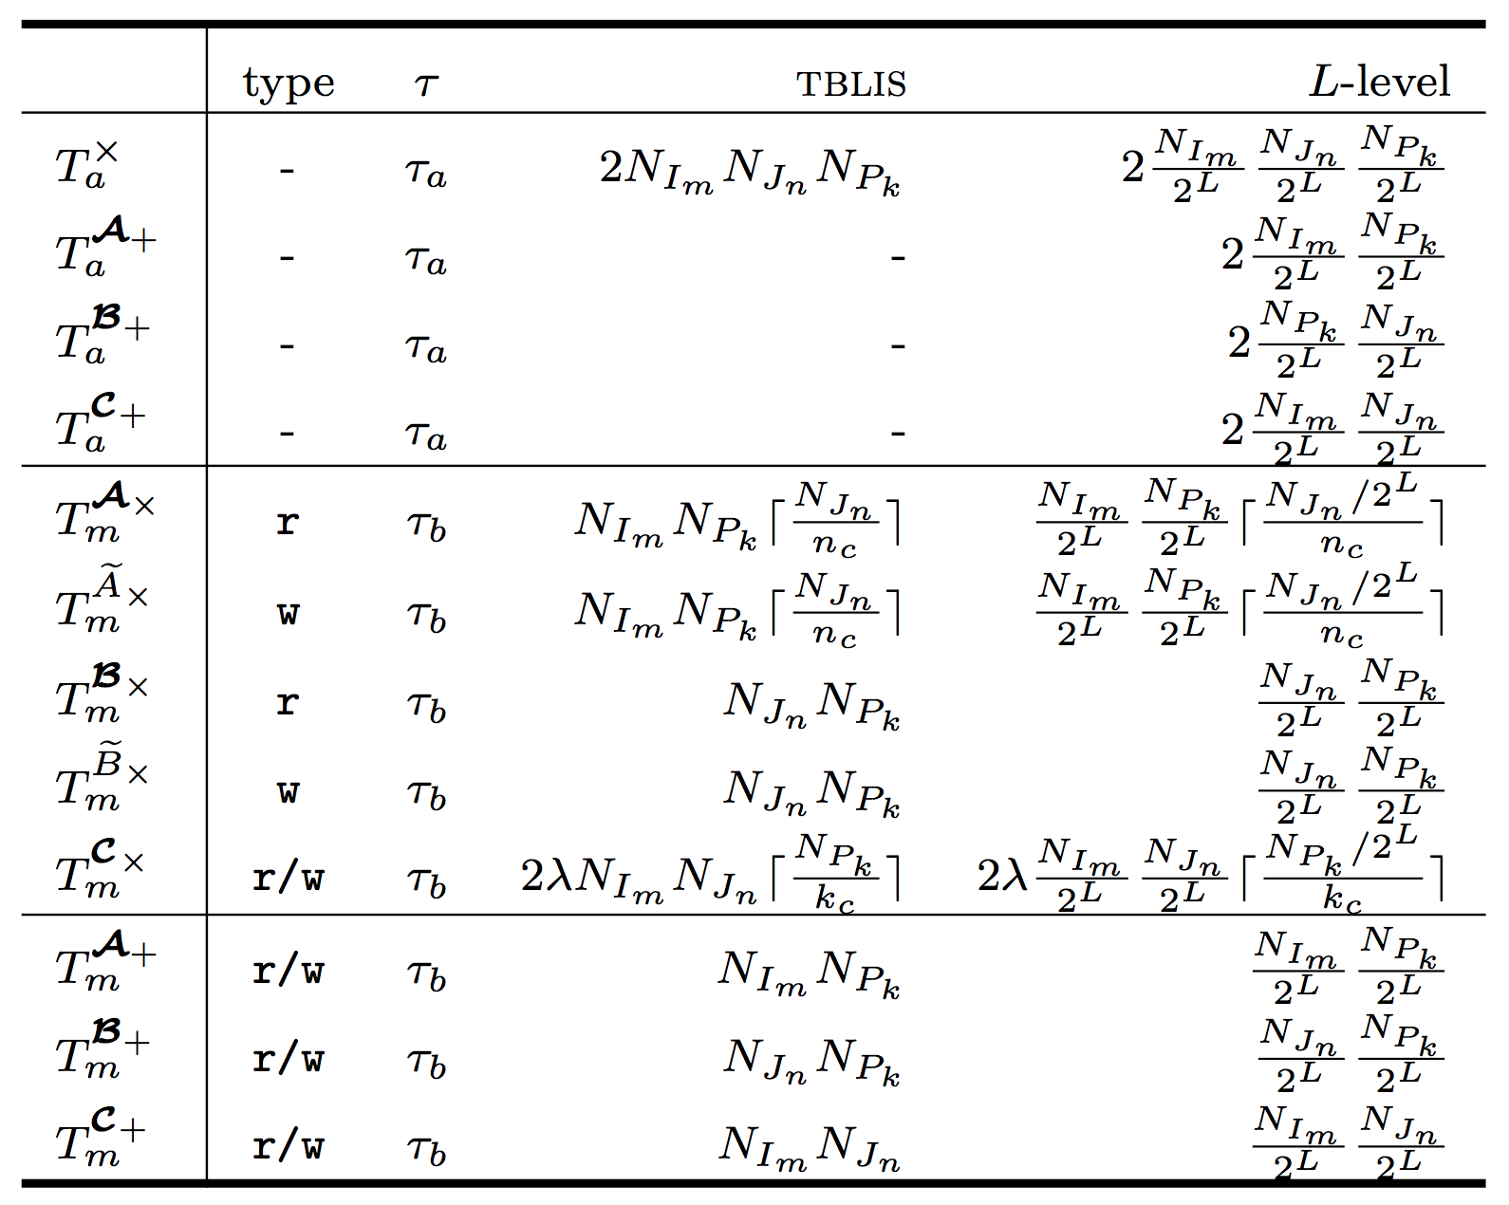
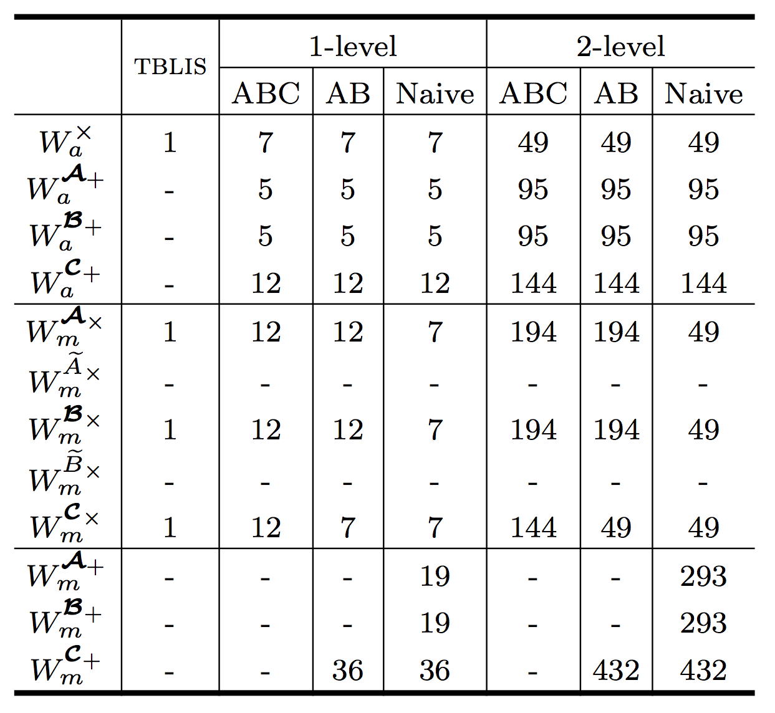

Slide 29
Outline
Background
High-performance GEMM
High-performance Strassen
High-performance Tensor Contraction
Strassen’s Algorithm for Tensor Contraction
Performance Model
Experiments
Conclusion

Slide 30
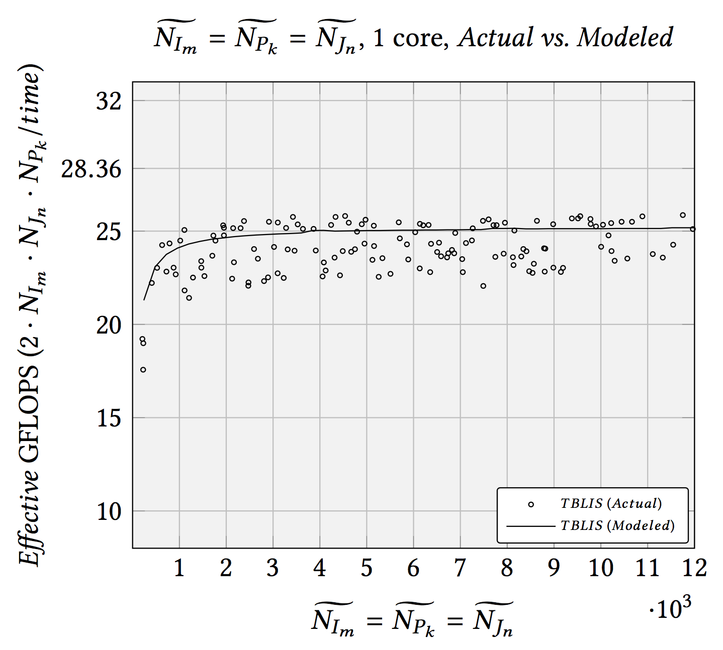

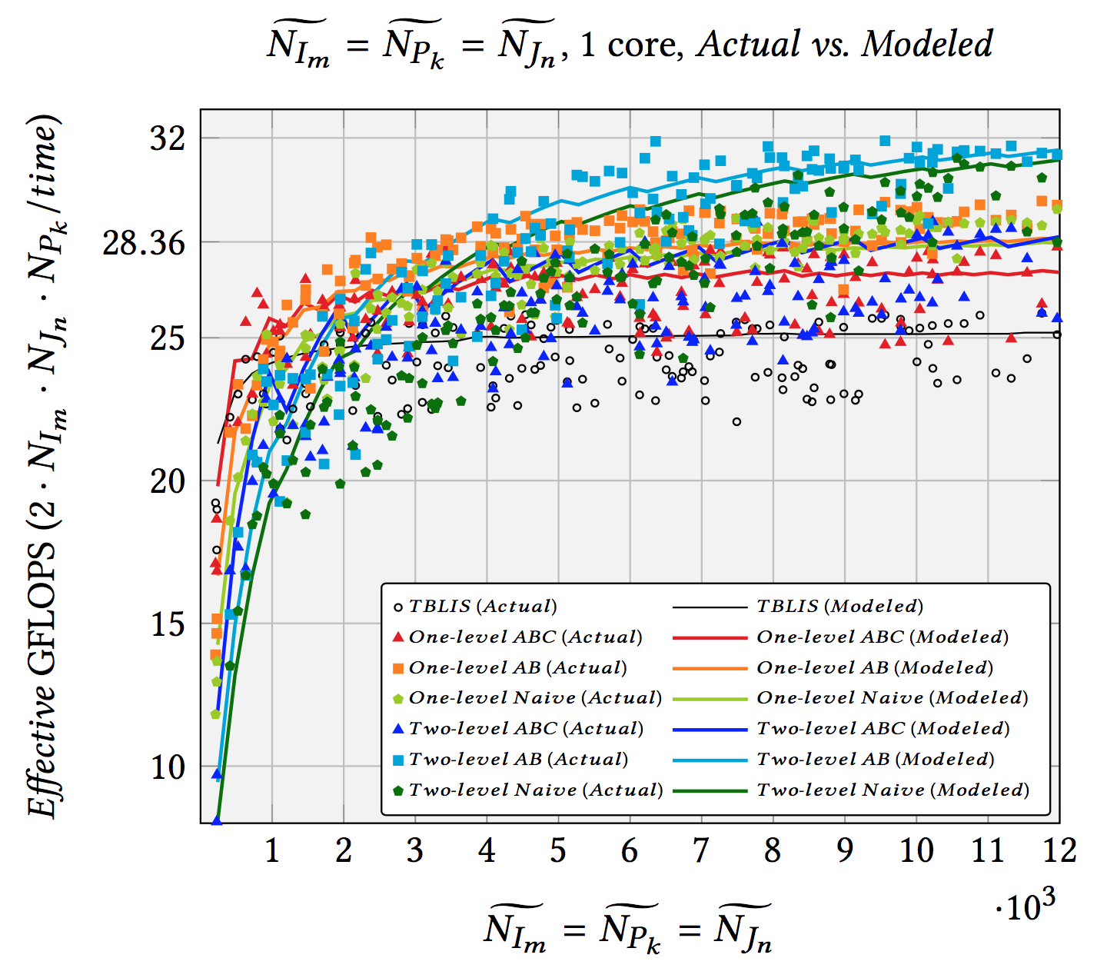
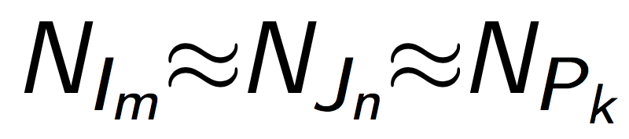
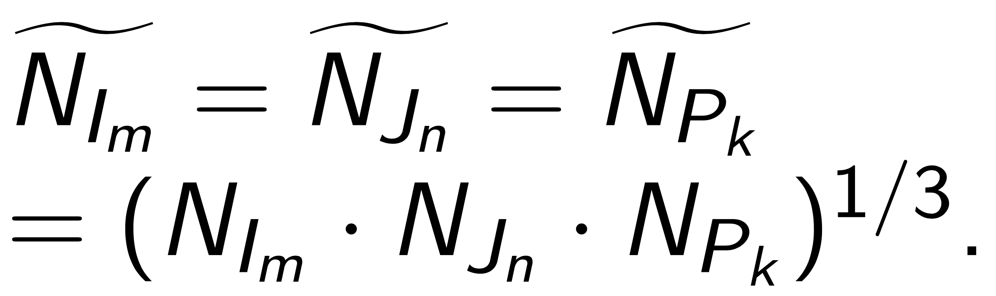

Synthetic Tensor Contractions
Intel Xeon E5-2680 v2 (Ivy Bridge, 10 core/socket)

Slide 31
Synthetic Tensor Contractions
Intel Xeon E5-2680 v2 (Ivy Bridge, 10 core/socket)

Slide 32
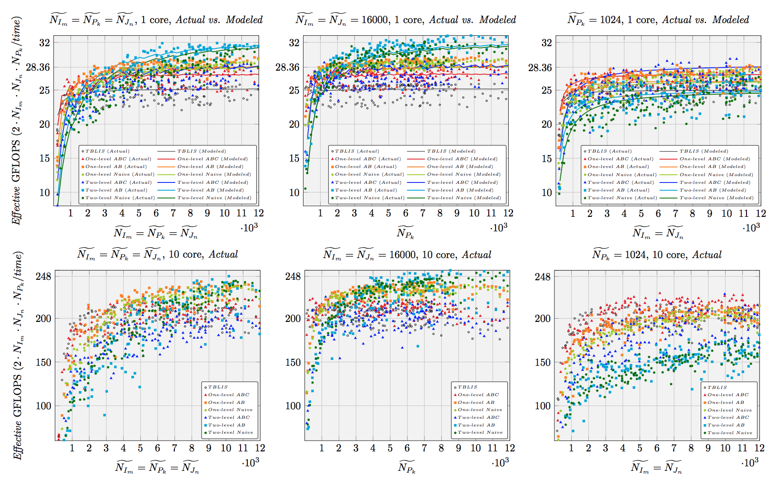
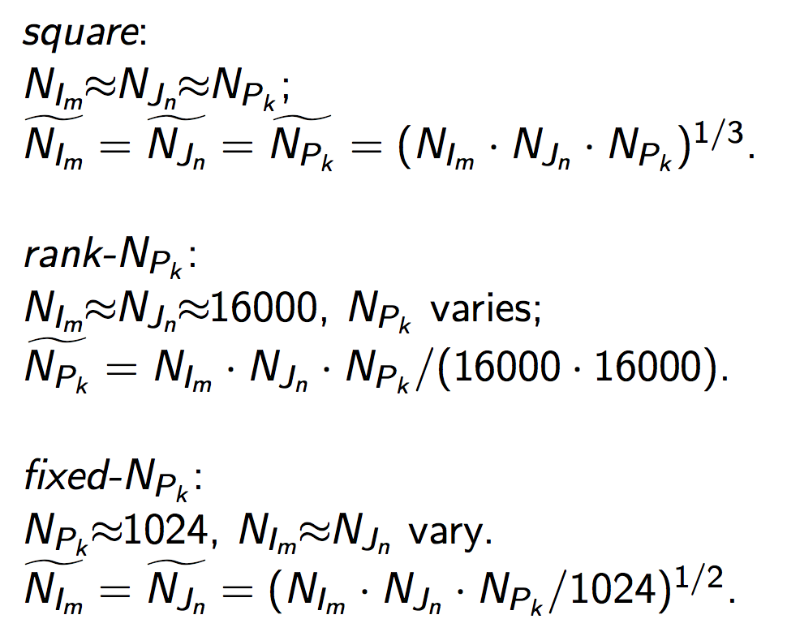
Synthetic Tensor Contractions
Intel Xeon E5-2680 v2 (Ivy Bridge, 10 core/socket)

Slide 33
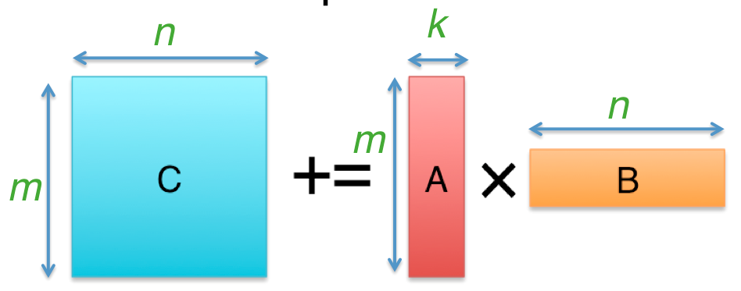

Synthetic Tensor Contractions
Intel Xeon E5-2680 v2 (Ivy Bridge, 10 core/socket)

Slide 34
Synthetic Tensor Contractions
Intel Xeon E5-2680 v2 (Ivy Bridge, 10 core/socket)

Slide 35
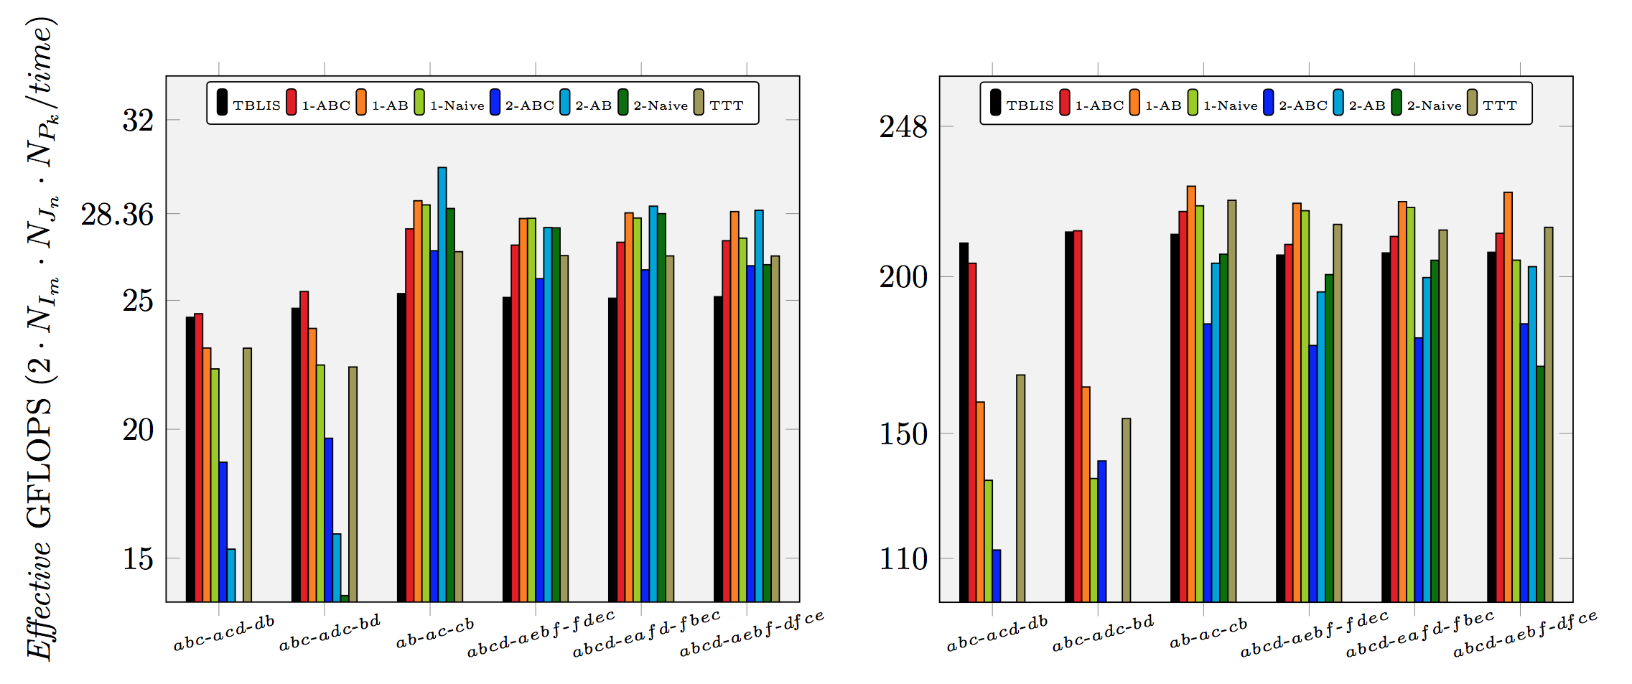
Real-world Benchmark
Intel Xeon E5-2680 v2 (Ivy Bridge, 10 core/socket)
is denoted as
Paul Springer, and Paolo Bientinesi. "Design of a high-performance GEMM-like tensor-tensor multiplication." arXiv preprint arXiv:1607.00145 (2016).

Slide 36
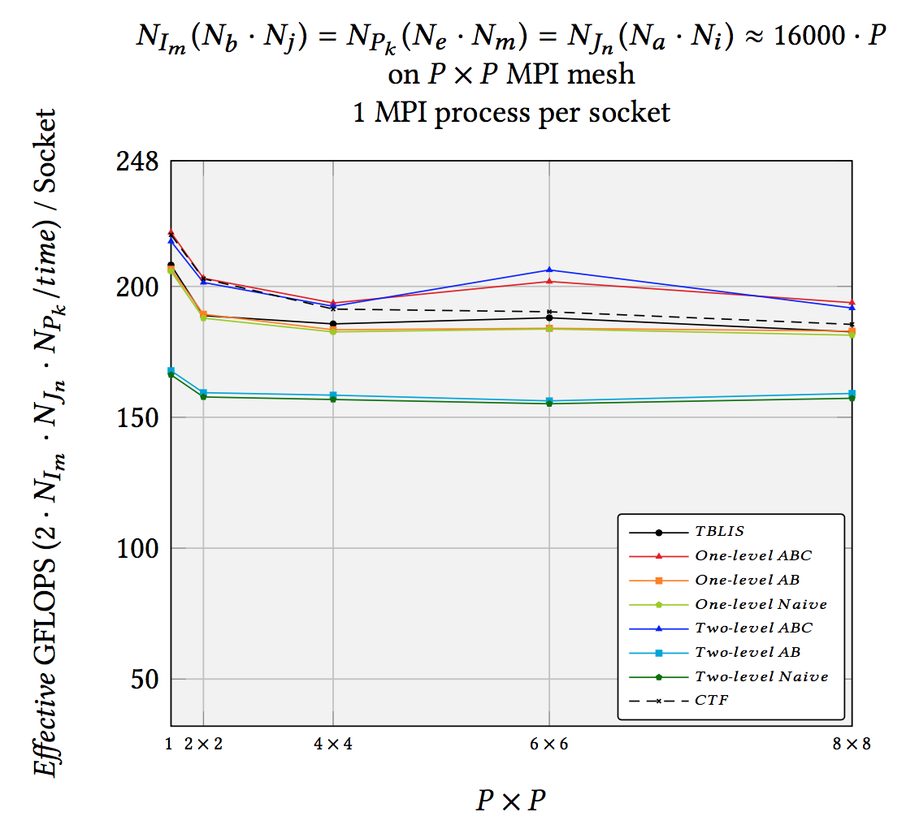
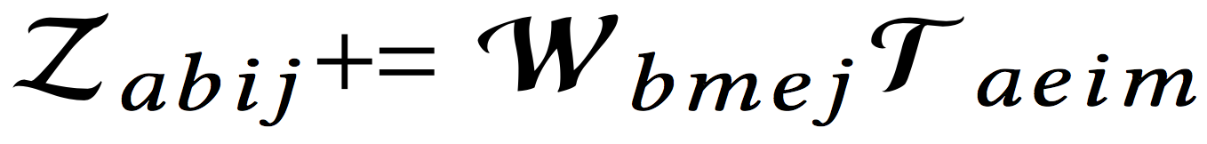
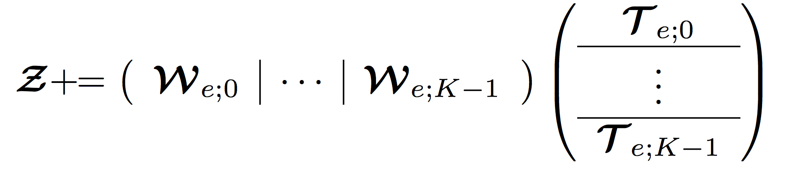
Distributed Memory Experiments
Weak scalability performance result of the various implementations for a 4-D tensor contraction CCSD application on distributed memory:
CTF shows the performance of the Cyclops Tensor Framework (linked with Intel MKL).
Solomonik, Edgar, Devin Matthews, Jeff Hammond, and James Demmel. "Cyclops tensor framework: Reducing communication and eliminating load imbalance in massively parallel contractions." In Parallel & Distributed Processing (IPDPS), 2013 IEEE 27th International Symposium on, pp. 813-824. IEEE, 2013.

Slide 37
Outline
Background
High-performance GEMM
High-performance Strassen
High-performance Tensor Contraction
Strassen’s Algorithm for Tensor Contraction
Performance Model
Experiments
Conclusion

Slide 38
Conclusion
First work to leverage Strassen’s Algorithm for Tensor Contraction.
Fusing matrix summation and permutations with packing and micro-kernel operations inside GEMM.
Avoiding explicit transpositions and extra workspace, and reducing the overhead of memory movement.
Achieving ~1.3x speedup on single core, multicore, and distributed memory parallel architectures.

Slide 39





Acknowledgement
- NSF grants ACI-1550493, CCF-1714091.
- A gift from Qualcomm Foundation.
- Intel Corporation through an Intel Parallel Computing Center (IPCC).
- Access to the Maverick and Stampede supercomputers administered by TACC.
We thank Martin Schatz for his help with distributed memory implementations, and the rest of the SHPC team (http://shpc.ices.utexas.edu) for their supports.
Any opinions, findings, and conclusions or recommendations expressed in this material are those of the author(s) and do not necessarily reflect the views of the National Science Foundation.

Slide 40
Thank you!
The source code can be downloaded from:
https://github.com/flame/tblis-strassen

